Slide 1
NCT Project:
Detector & Descriptor Outlier Rejection Evaluation for SLAM in MIS
Nicolas Schmitt, Boyang Liu, Florian Thiessenhusen

Slide 2
Structure
Introduction to Topic and Difficulties
First Ideas and Research
Different Implementations:
  RANSAC
  Optical Flow
Other Feature Detectors

Slide 3
Introduction to Topic and Difficulties

Slide 4
First Ideas and Research
Starting point: ORB features, Optical Flow, Extended Kalman Filters
No material on Kalman Filters → rejected
Additional methods: RANSAC (and variations)
Concentrated on RANSAC and Optical Flow
Python for implementations

Slide 5
Different Implementations: RANSAC
Common algorithm for outlier detection
Multiple iterations of calculation and comparison
Number of data points for calculation should kept small
Calculation of movement between images:
  Homography
  Essential Matrix
  Fundamental Matrix
OpenCV implementations

Slide 6
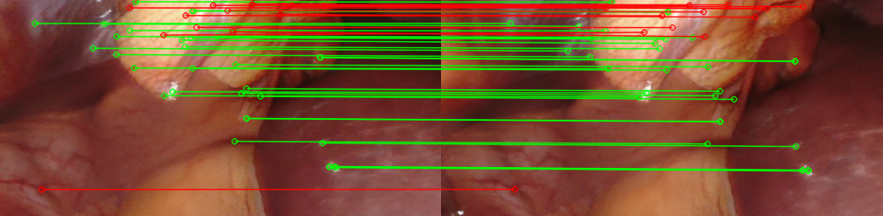
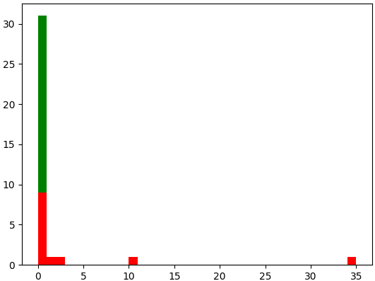
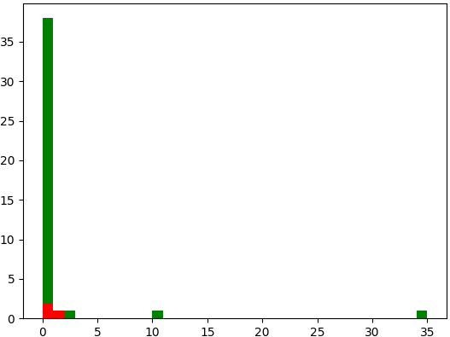
Different Implementations: RANSAC
Fig. 1: inliers and outliers RANSAC (Homography)
Fig. 2: distance histogram RANSAC (Homography)
Fig. 3: distance histogram RANSAC (Fundamental M.)

Slide 7
Different Implementations: RANSAC
Common algorithm for outlier detection
Multiple iterations of calculation and comparison
Number of data points for calculation should kept small
Calculation of movement between images:
  Homography
  Essential Matrix
  Fundamental Matrix
OpenCV implementations
Extension: local RANSAC on detected areas in image

Slide 8
Different Implementations: Optical Flow

Slide 9
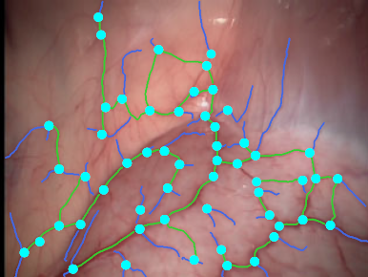
Other Feature Detectors
Fig. 4: blood vessel features
[1]
Higher number of features needed than ORB provides
Tested different typical detectors included in OpenCV (SIFT, SURF, …)
May also try out other detectors e.g. SuperPoint
Use case specific features:
  Blood vessel features
  Good results in endoscopic applications

Slide 10
Questions

Slide 11

References for this Presentation
´Presentation Layout by Dresden Concept
[1]: B. Lin, Y. Sun, J. E. Sanchez and X. Qian, "Efficient Vessel Feature Detection for Endoscopic Image Analysis," in IEEE Transactions on Biomedical Engineering, vol. 62, no. 4, pp. 1141-1150, April 2015, doi: 10.1109/TBME.2014.2373273.

